Slide 1
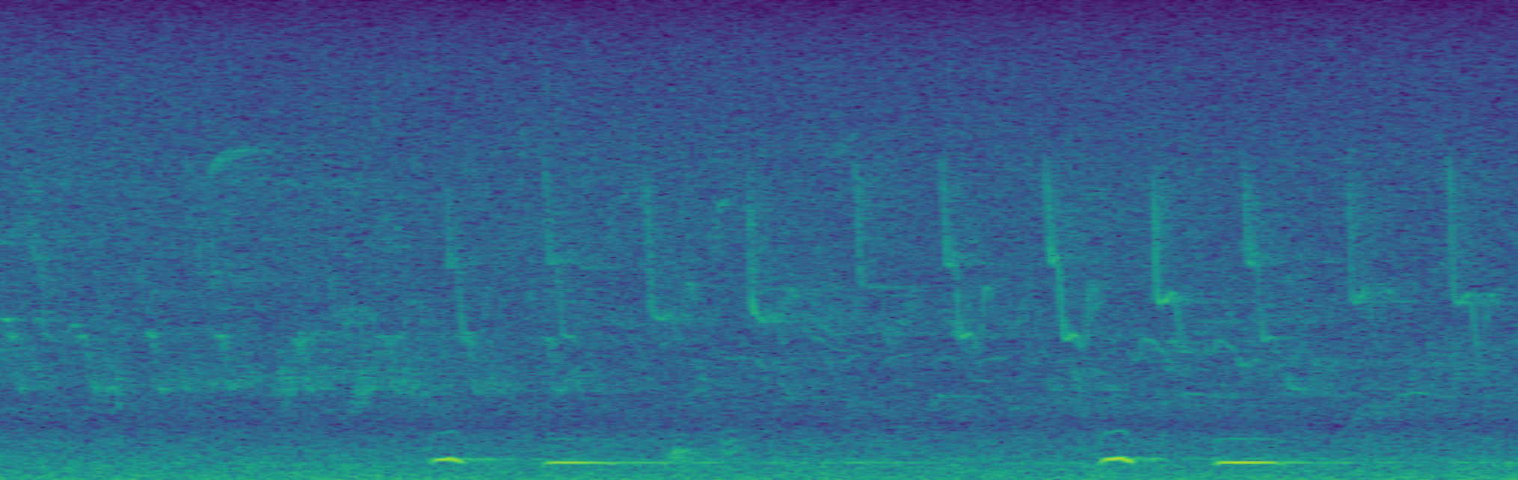
Task 4: Challenge
Team Vegetable
Sandro Assek
Petruta-Simina Coroian
Lukas Himmelbauer
Christoph Wittner

Slide 2
Data split
To be able to evaluate the learned models also offline (not on the challenge server), we split the given training samples into two sets, using 4/5 to train models and 1/5 to estimate the total savings
This was done by assigning 20% of files of every bird class to the validation set, to ensure that the models never see any part of the recordings used for testing during the model selection procedure

Slide 3
Stratified CV
For all of our experiments the training data was again split in 5 folds to do cross-validation. We used stratified cross-validation provided by sklearn, as we want to ensure that we have samples of each class in all 5 folds.
Our results are averaged over the 5 folds to get a more confident estimate than by only taking one split of the data
Before getting the final predictions on the provided test data for the challenge, the models were retrained using all training data (without keeping a split for validation) to further improve performance by using more data for training

Slide 4
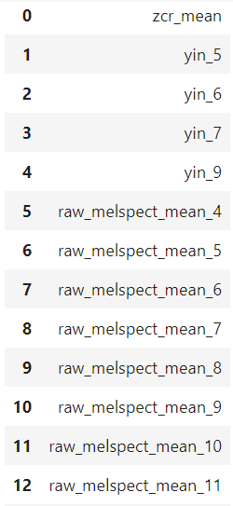
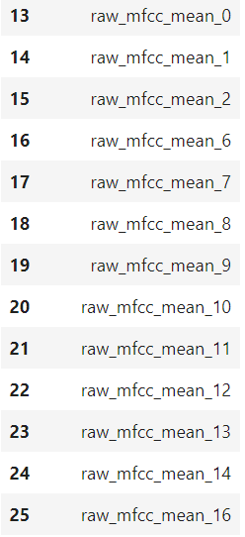
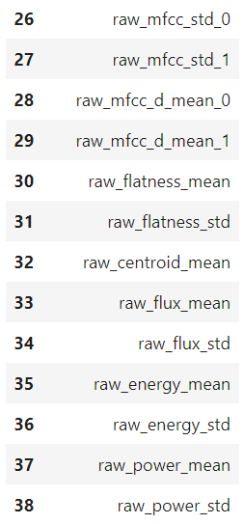
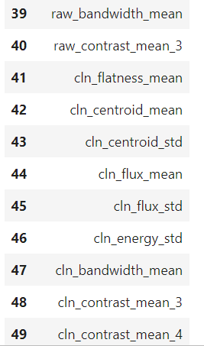
Top 50 Features chosen by mutual information gain

Slide 5
Post-processing
Flip single and double gaps (zero predictions between bird call predictions), as they are not considered during evaluation and this lets us get rid of wrongly predicted interruptions in longer calls
Slide a 6s (30 data points) window over the predictions and predict the most occurring bird, as the data consists of snippets of at least 6s containing only one bird
For models predicting class probabilities (NN, CNN), we adjusted the prediction confidence if predictions were „unbalanced“ (e.g. Increase the probability of predicting class X if zero is predicted too often for this class and the data point would be predicted zero without adjusting)

Slide 6
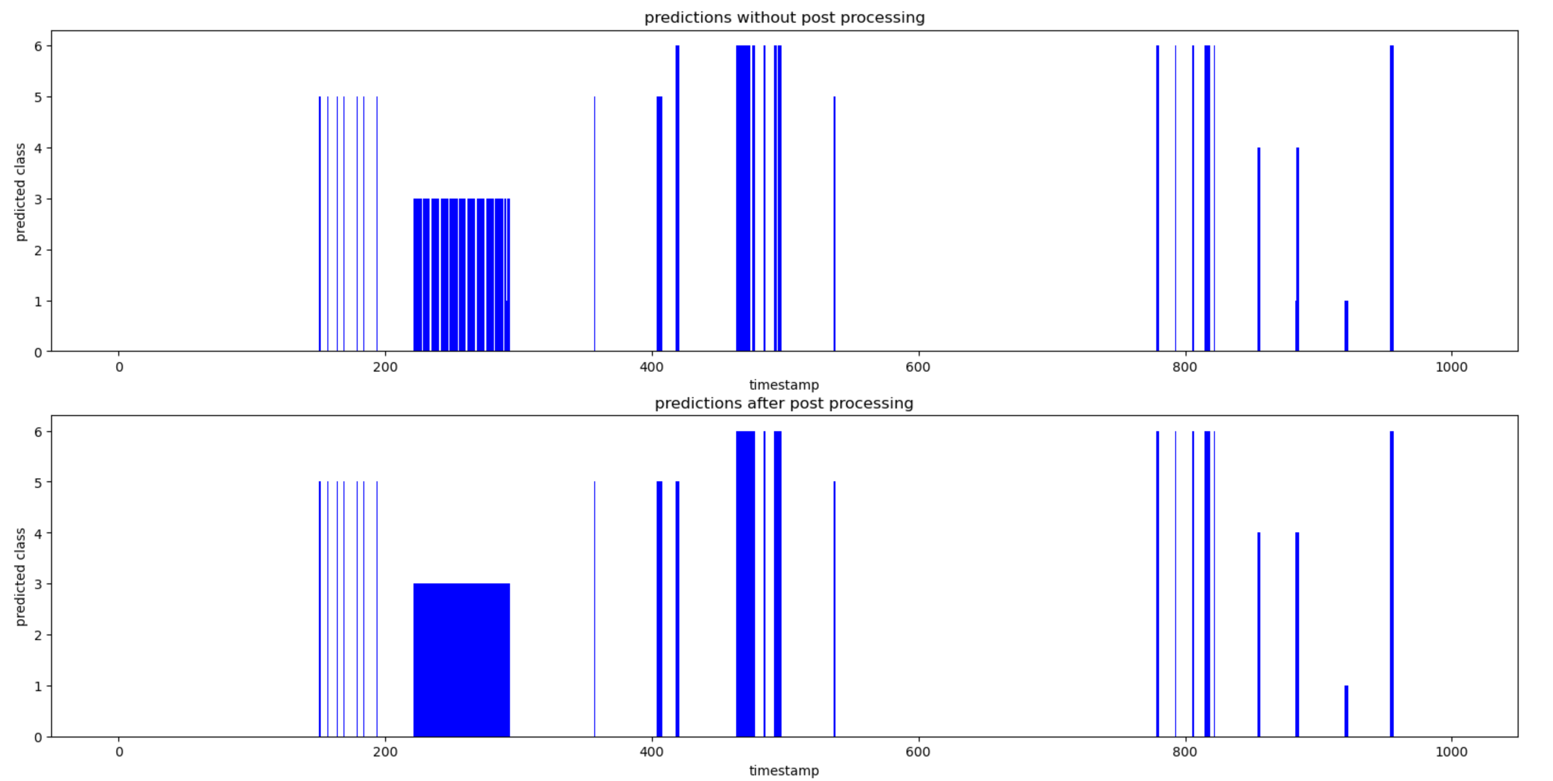
Post-processing
As visible in the picture, small gaps in the predictions have been removed and the predicted bird is more consistent than before

Slide 7
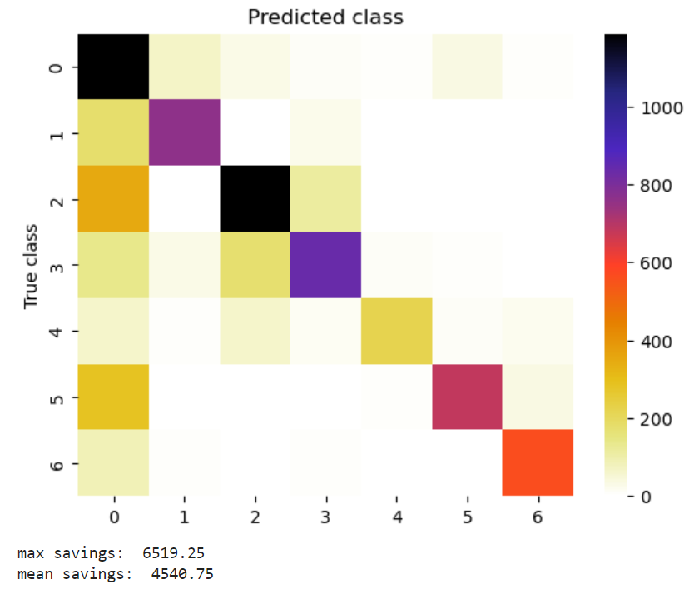
Random forest
Parameters:
n_estimators: 400
criterion: log_loss
max_features: sqrt
max_depth: 40
min_samples_split: 2
min_samples_leaf: 1
bootstrap: False
Results:
The parameters used for all RF experiments were conducted using randomized search and afterwards grid search for fine-tuing
As we can see, the RF-classifier has a hard time detecting some bird calls (see left column of the results heat map

Slide 8
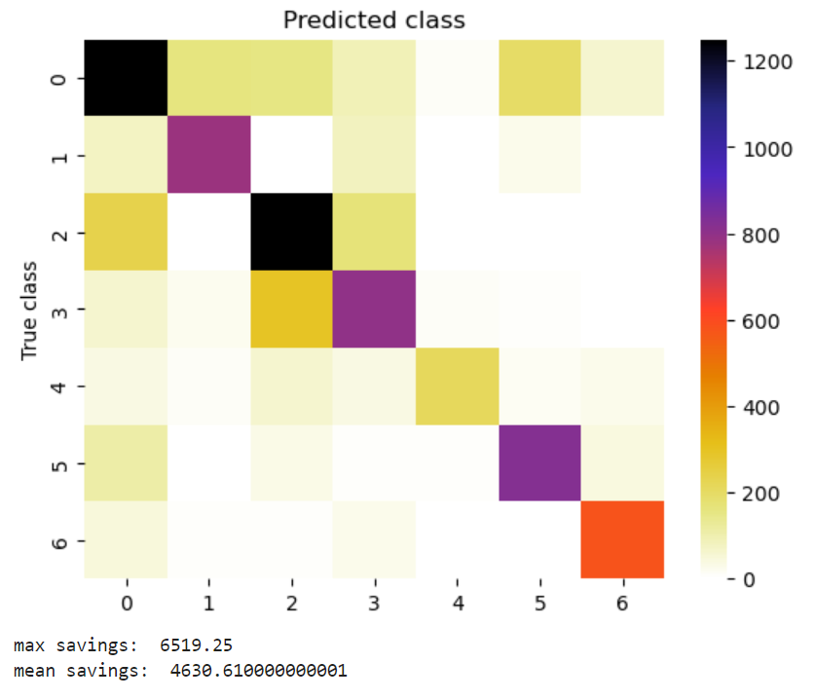
Random forest stack
The idea was to train one RF to predict where bird calls are and where not and another RF which takes this additional information to make the final predictions, in order to tackle the missed calls
Parameters RF-birdcall:
n_estimators: 300
criterion: log_loss
max_features: sqrt
max_depth: 110
min_samples_split: 3
min_samples_leaf: 2
bootstrap: True
Parameters RF-final:
n_estimators: 400
criterion: log_loss
max_features: sqrt
max_depth: 40
min_samples_split: 2
min_samples_leaf: 1
bootstrap: False
Results:
As we can see, stacking the two RFs slightly increases the performance

Slide 9
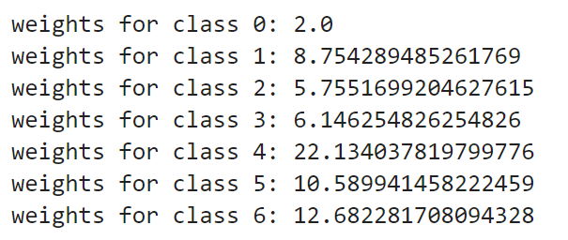
Gradient Boosting
To account for the inbalance of classes, sample weights were calculated to give a higher importance to samples of classes that don‘t occur that often
These class weights were calculated by taking the reciprocal value of the number of times each class occured in the data set
After deviding the weights by 2 and setting the weight for class 0 to 2 (as this seemed to give better results) the resulting weights are:

Slide 10
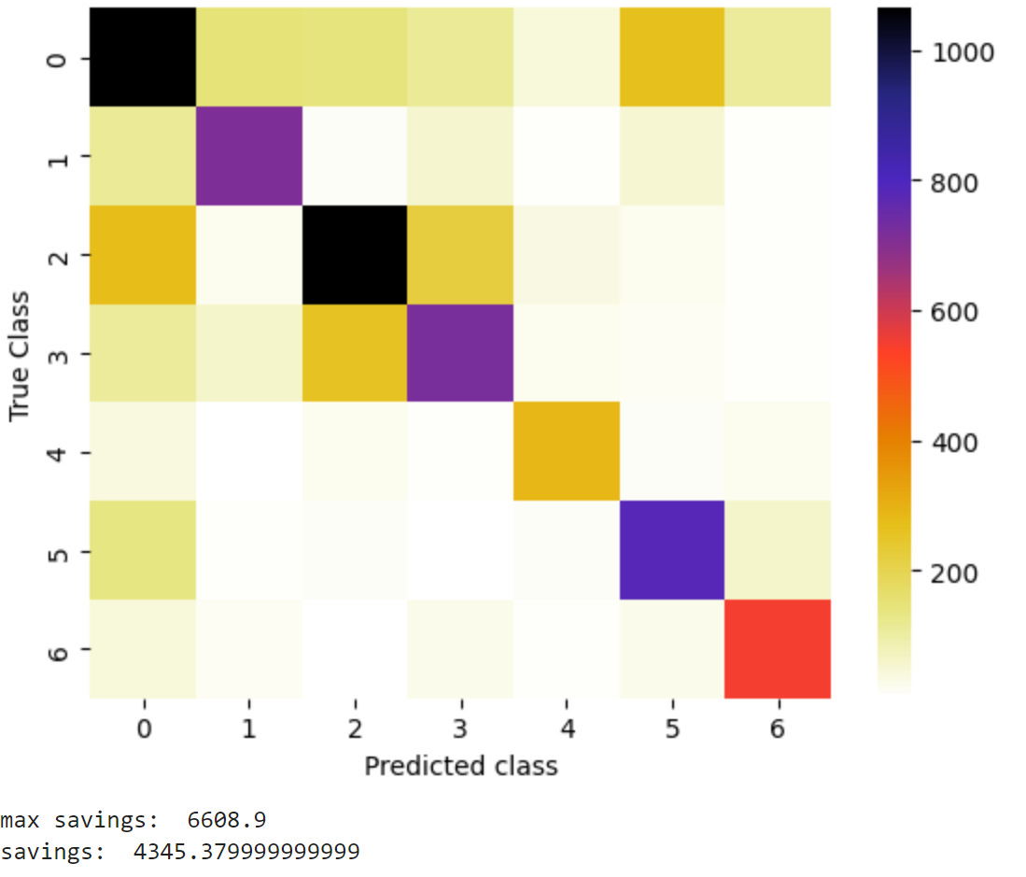
Gradient boosting
The reslults of a model with 400 estimators, a learning rate of 0.1 and a max_depth of 4 is shown here:
We can see that the classifier was able to detect some of the classes rather good, but in comparison to some of our other models the performance was worse

Slide 11
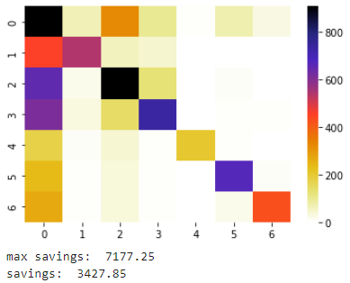
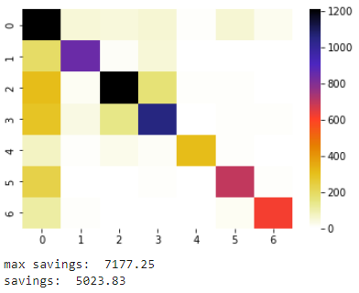
SVM
sklearns SVM settings from Task 3:
[kernel=‘rbf‘, C=4, tol=1e-3, gamma=‘auto‘]
Training on 50 features and bird calls according to sampling from Task 3, clearly (left Confusion Matrix) SVM has a hard time detecting any bird calls
Applying postprocessing on the raw prediction sequences of the test set increases the models’ (right Confusion Matrix) ability to detect bird calls and leads to an increase in approximated savings.

Slide 12
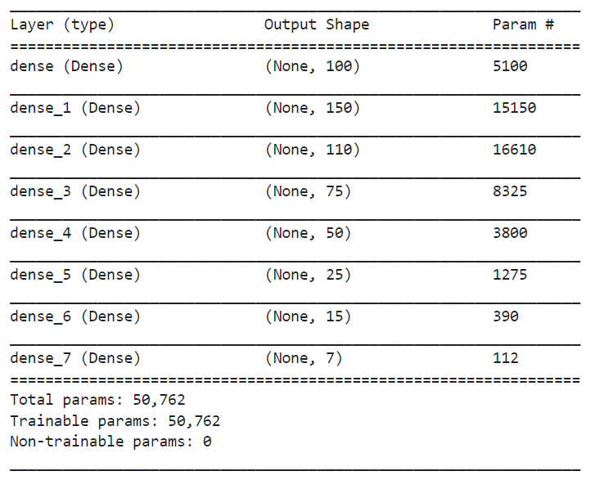
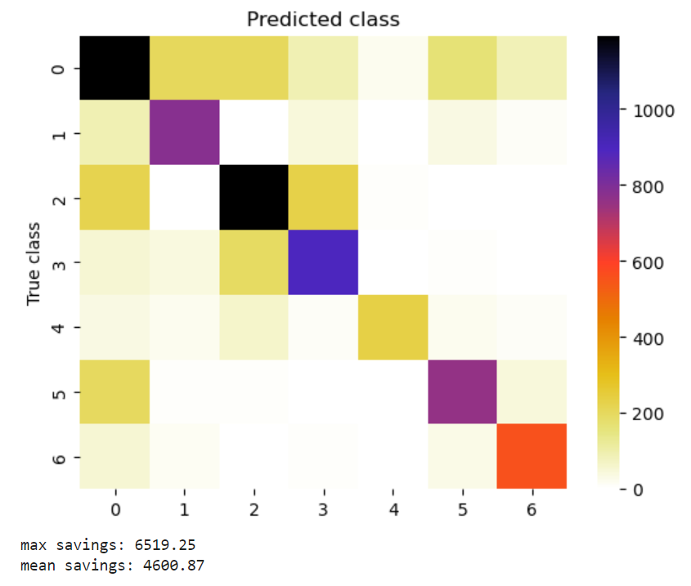
NN
Architecture:
Results:
Looking at the results we archived with a feed-forward neural network, we see that they do not give the most impressive results. One reason might be, that no sequential information is taken into account.

Slide 13
CNN
The best results we got were obtained using a CNN. In order to be able to use CNNs, the data loading had to be slightly adjusted, as we needed whole sequences instead of single data points as input.
Since we have 10-minute recordings (3000 data points) as Test data, the 20s recordings we got as training data were concatenated 30 times to get the correct shape (instead of padding the sequence, as this would have led to training data consisting of only 1/30 actual data and 29/30 padding values)

Slide 14
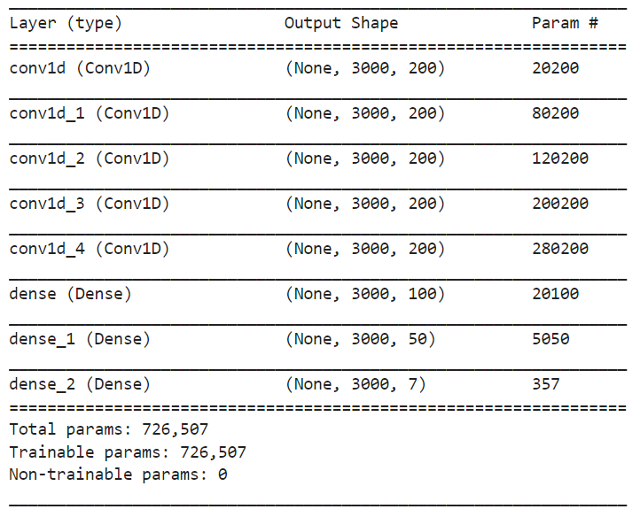
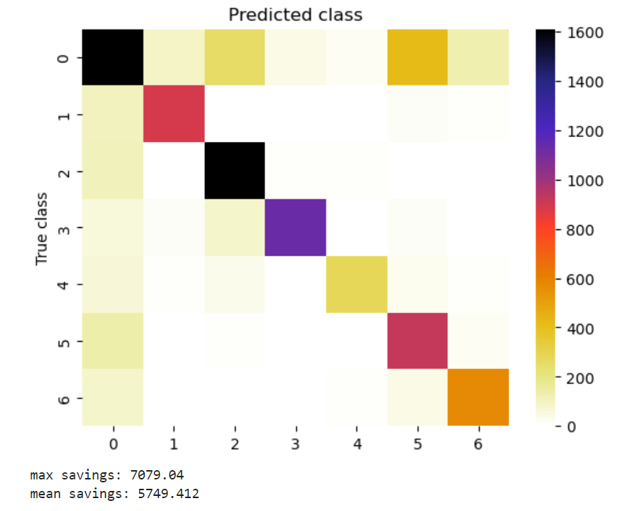
CNN
Architecture:
Results:
As we can see, taking sequential information into account by using a CNN improves the performance by a big margin.

Slide 15
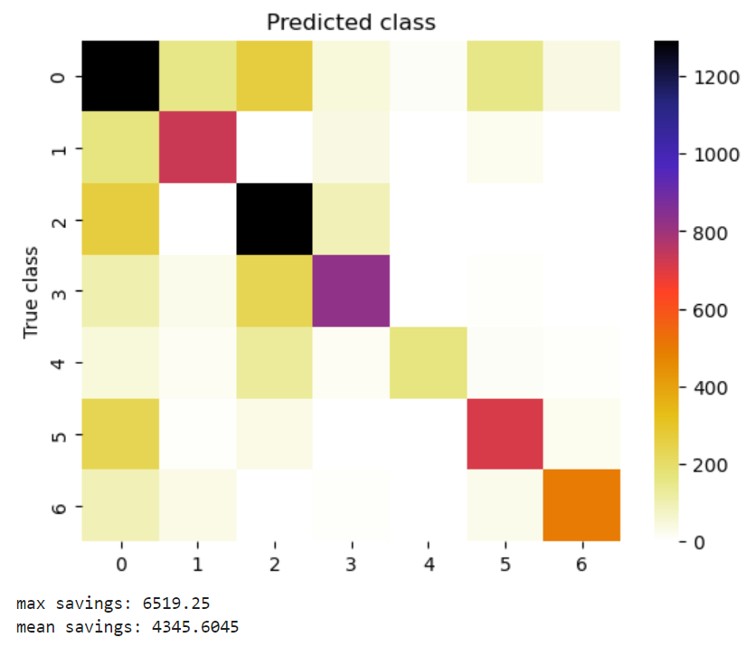
Extreme learning machine
We found this approach in related literature (Bird Sounds Classification by Large Scale Acoustic Features and Extreme Learning Machine by Qlan, Zhang, Ringeval, Schuller)
An extreme learning machine typically uses only one hidden layer with randomly initialized weights which are not updated during learning. Only the weights from hidden- to output-layer nodes are learned.
The main adjustable parameter in ELMs is the size of the hidden layer, for our experiments a size of 10000 turned out to give the best results.
There might be better results obtainable with ELMs, as our manual implementation of this network restricted the maximum size we could use for the hidden layer due to memory restrictions
Results:

Slide 16
Conclusion?

